Slide 1
Analyzing User Engagement on Social Media Platforms
SOCIAL MEDIA TIME ANALYSIS.
Presented by:
Jasmine Imbuka

Slide 2
Introduction to the Dataset content:
Dataset: Average Time Spent By User on Social
Media Goal: To analyze user engagement on various social media platforms and identify trends in user behavior.

Slide 3
Import Process Content:
Import Process:
Imported the dataset into MySQL Workbench.
Created a table time_spent with columns: user_id, platform, average_time_spent, date.Loaded the dataset into the table using MySQL’s LOAD DATA INFILE command.
Interesting Finding:
Users spend the most time on YouTube, with an average of 130 minutes per user.

Slide 4
Cool Facts Content:
Fact 1: Facebook has the highest number of users among all social media platforms.
SQL Query:
SELECT platform, COUNT(user_id) AS
user_count FROM time_spent GROUP BY platform ORDER BY user_count DESC LIMIT 1;
Fact 2: Users spend the most total time on social media on January 1st.
SQL Query:
SELECT date, SUM(average_time_spent) AS total_time_spent FROM time_spent GROUP BY date ORDER BY total_time_spent DESC;

Slide 5
Questions and SQL Queries Content:
Question 1: Which social media platform do users spend the most time on, on average?
SQL Query:
SELECT platform,
AVG(average_time_spent) AS
avg_time_spent FROM time_spent GROUP BY platform ORDER BY avg_time_spent DESC LIMIT 1;
Question 2: What is the total time spent by users on social media per day?
SQL Query:
SELECT date, SUM(average_time_spent)
AS total_time_spent FROM time_spent GROUP BY date ORDER BY total_time_spent DESC;

Slide 6
Insights Content:
Platform Usage: YouTube is the platform where users spend the most time on average.
High Engagement Dates: Engagement peaks on significant dates like holidays and weekends, with January 1st showing the highest total time spent.

Slide 7
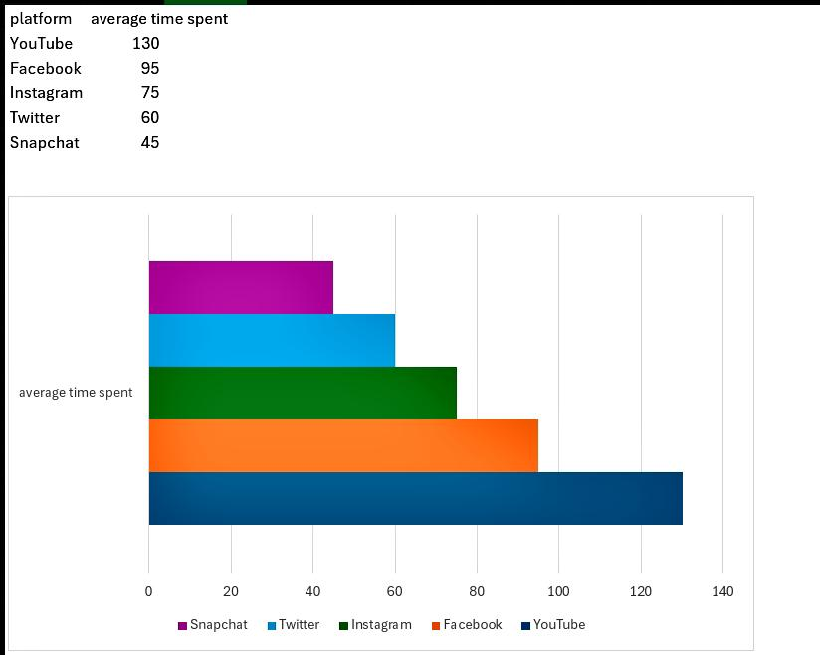
Data Visualization Content:
Description: Bar chart showing the average time spent by users on each platform.

Slide 8
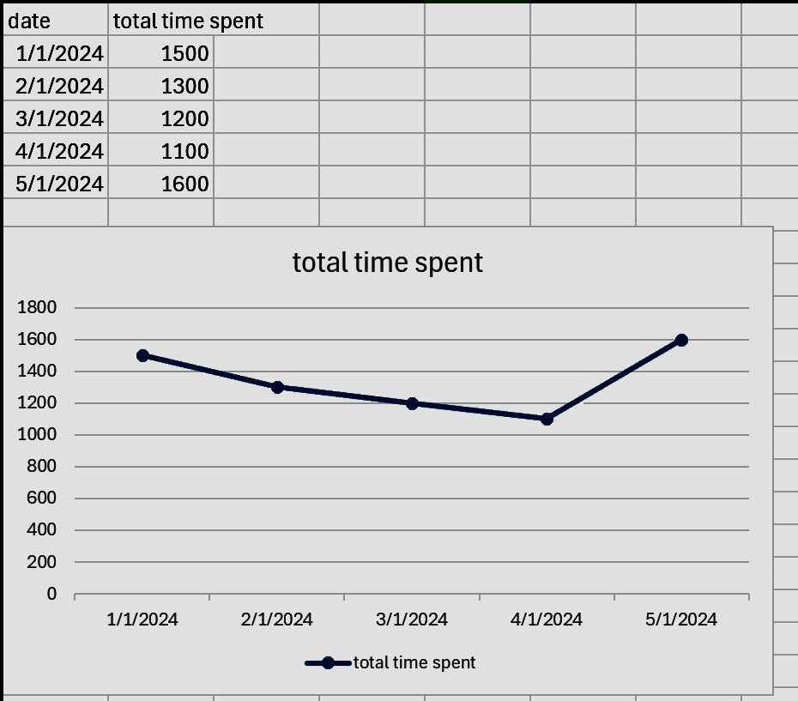
Contin…Total Time Spent on Social Media per Day
Description: Line chart showing the total time spent by users on social media each day, highlighting peaks on significant dates.

Slide 9
Project Summary Content:
Goals Achieved:
Analyzed user engagement on social media platforms . Identified trends in user behavior.
Key Findings:
YouTube has the highest average time spent per user . Facebook has the highest number of users . Engagement peaks on significant dates like holidays and weekends.
Future Work:
Further analysis on user demographics . Predictive analysis on future engagement trends.

